Slide 1
Pup
Putting Your Best Case Forward: Developing a Portfolio Narrative
Kandice Porter, Interim Associate Dean of Academic Affairs
Mark Geil, Associate Dean of Research and Operations
Wellstar College of Health and Human Services
April 15, 2022

Slide 2
Workshop Overview
Write your own Adventure story
An exciting experience or undertaking that is typically bold
Adventures are often undertaken in pursuit of knowledge that may involve unknown risks
What to include in your story
Advice on the process
Discussion

Slide 3
Writing the Story of all you’ve accomplished during the review period
Your narrative provides a broad overview of who you are, what you have contributed, and why it’s a good idea to retain you or reward you with a promotion
Should be a clearly written and persuasive story
Recognize that you are writing for multiple audiences
Some may not know the expectations you’ve been under
Many will not know of the accomplishments you’ve achieved
Most are not from your field

Slide 4
Write Your Own Story (but be aware of expectations)
KSU Faculty Handbook, Sections 3 provide guidance on the quality and significance of accomplishments and general expectations for promotion and tenure
In the Wellstar College, no P&T guidelines but there are workload expectations
Refer often to your departmental P&T guidelines for specific criteria for promotion and tenure and required documentation

Slide 5
There are two aspects of the portfolio preparation to manage….

Slide 6
There are two aspects of the portfolio preparation to manage….
Portfolio Narrative
Supporting Documentation
Work on this when you are feeling creative, inspired, or just highly motivated
Work first on getting it all down
It takes time to tell a compelling & concise narrative story rather than a rambling, less focused one
Give yourself time to edit and improve each iteration!
Gathering, documenting, and organizing information
Work on these pieces when you do not feel like thinking but still need make progress
Will need to move back and forth between these two..

Slide 7
KSU Portfolio Requirements
Faculty Handbook, Section 3.12
No more than 12-pages, double-spaced, 12-point type, with one-inch margins
Format for the Narrative:
Executive summary and/or introduction
Teaching
Research
Service
Conclusion
Each section should include references to supporting documents
Not everything you do will fit neatly into separate categories; blending of categories will sometimes happen

Slide 8
What happens if you sit down to write, and you do not know where to start
Develop a realistic timeline to develop your portfolio
Review your CV & ARD and start creating a list of your most significant accomplishments
Highlight accomplishments that provide evidence that you are already performing at the level in which you seek
Find balance between situational context and your career goals, major contributions to date, and a clear vision of where you’re heading in the future
Note: first paragraph of each section should be written to help orient the reader

Slide 9
Give Yourself the Same Advice You Would a Student

Slide 10
Approach the writing process as your previous writing instructor would have suggested:
Start early: Do not put off drafting your narrative!!!
It typically takes much more time than anticipated to carefully and systematically gather, integrate, and organize your material into a coherent but concise document
Plan on writing multiple drafts; work toward a clear, comprehensive and compelling argument
Ask colleagues to provide feedback on your draft(s)
Be sure to include at least one colleague from OUTSIDE your department, who is not closely familiar with your discipline
Be very conscientious about your final editing process

Slide 11
Teaching Section of Portfolio Narrative
Tell a “story” of you teaching, including efforts to improve, change over time, and what you will try next
Explain your conception of teaching and learning, how you teach, and why you chose to teach that way
Demonstrate your enthusiasm and commitment to teaching
Most readers will not know the significance of your classes, how they relate, and the importance for future professionals in your discipline
Point to evidence of teaching successes

Slide 12
Questions to Consider When Preparing the Teaching Section of Your Narrative
What is your “story”? Why are you engaged in this profession?
What do you love best about teaching? When is it most rewarding?
How do you want your students to change as a result of your classes?
What new things should they be able to do, say and know?
Who are your students?
What are their strengths coming into your program?
What are their needs?
What are the challenges of teaching in your discipline?
How do your students learn best?
What strategies do you employ to help them learn?
How do you address all of this in your classes?
What do students say about your classes?
What do peers say about your classes?
What evidence do you have that shows you are effective at getting students to learn? And what have you learned along the way?
How has what you’ve learned changed your teaching?
How can you document those changes
What efforts have you made to improve your teaching?
How have you documented these efforts?
Have you mentored students? (anything you do to help students to be successful serves the educational mission of our college)
Where do you want to go now?
What is exciting in the future?
What do you want to tackle next in your teaching?

Slide 13
Research Section of Portfolio Narrative
Start with a general overview of your research in ways someone not in your field can understand
Tell the reader what it is you do, why you’re excited about doing it, and why it’s an interesting (valuable) line of inquiry
Paint a picture of your research agenda, capabilities, results, and recognition received for our competence and creativity
Reviewers also want to see that you’re not done! Share how you envision your next steps or future research endeavors

Slide 14
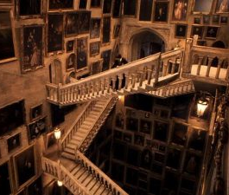
Lines of Research?
Craft them all into one narrative or sequence, if possible
Reference publications and broad impact
Choose how to define your reputation as a scholar and your future

Slide 15
Questions to Consider When Preparing the Research Section of Your Narrative
How did you get into your line of research? What first got you interested in this field?
What is your research? How would you explain it to someone outside academia?
What are the themes or strands of your research? Are there several or one?
What’s important about your research? Why should others care about your research?
What is particularly interesting to you about what you are studying? Why do you ask the questions you’re asking?
What are your specific and unique contributions to the field?
What new directions have you taken?
How is it different from what your peers are doing, in terms of format, methods, or results?
How are the results of your research useful to others? What difference have you made?
How do you know that your contributions are important? Who has recognized them and how?
How do your research interests overlap with teaching and service activities?
What do you want to try next? What research questions or directions are interesting to you?
Provide details on the quality and significance of your role on joint projects, grants, publications and presentations

Slide 16
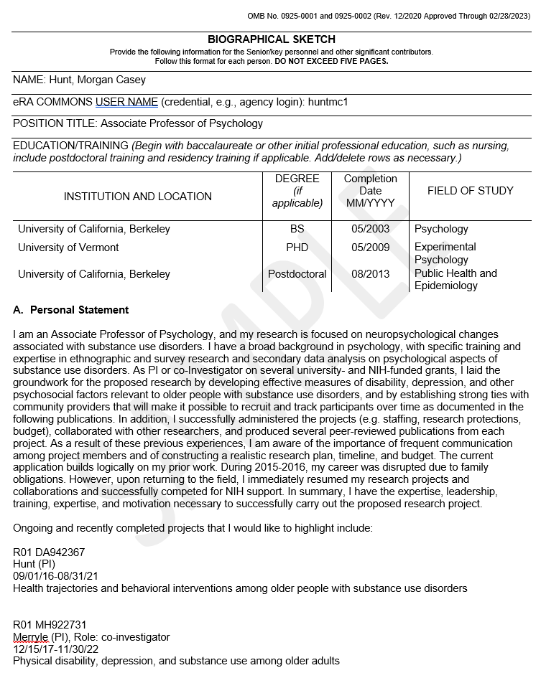
Contributions to Science: NIH Biosketch

Slide 17
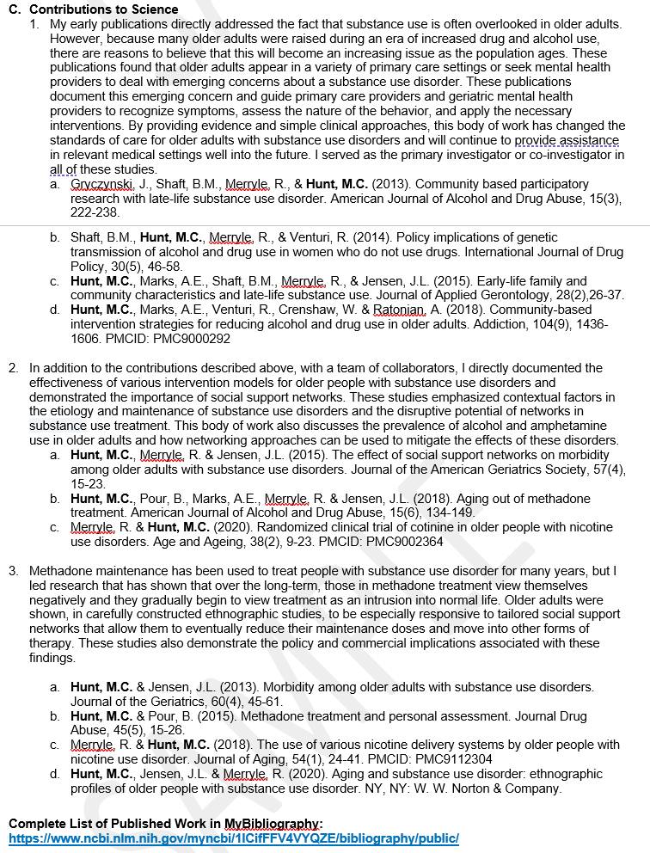
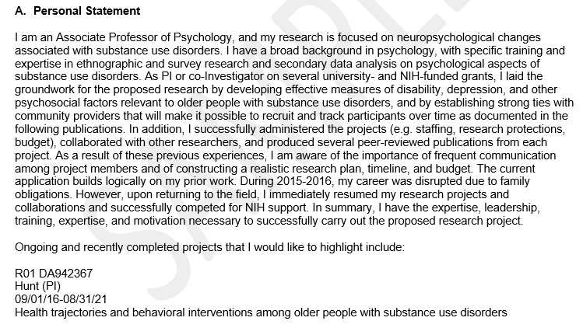

Slide 18
In Preparation/Review/Press
Be careful! “In Preparation” can mean “I’m not great at getting my results out into the world.”
Suggestions
leave off of CV
clean up DM
discuss as part of future directions, be specific about progress
Photo by Sharon McCutcheon on Unsplash

Slide 19
Unfunded Grant Proposals
Be careful! “Submitted but not awarded” can mean “My research ideas don’t merit external funding.”
Suggestions
leave off of CV?
clean up DM
discuss as part of well-considered path to external funding
Photo by Sharon McCutcheon on Unsplash

Slide 20
Service Section of Portfolio Narrative
Describe how you’re a positive contributor to KSU and your profession
Explain your involvement & contributions in your community that is related to your disciplinary expertise
What have you done?? Otherwise, the assumption is that you showed up for meeting
Your cv should have all service activities listed. This is where you explain your why!
Highlight leadership roles and accomplishments

Slide 21
Questions to Consider When Preparing the Service Section of Your Narrative
What kinds of service have you done at the department, college and University level?
Why did you choose these kinds of service over others? What do you value in them?
What kinds of service have you done in your profession?
Why did you choose these activities? Why do you value them?
What is your definition of “service” in your profession and at the university? Why was it important for you to engage in this service?
How are your service activities connected to your research interests?
How are your service activities connected to your teaching interests?
What are common threads that run throughout your service activities? In what ways are these activities connected thematically or philosophically to one another?
What’s important about your service?
What difference have you made? What has changed because of your work?
How have your contributions helped the University and your profession?
What would you like to continue doing? Why?
What do you want to try next? What new questions or service directions are interesting to you?

Slide 22
How to Address Weaknesses?
Your story is also the place to acknowledge and address issues that might be perceived as weaknesses
Demonstrate that you recognized the issue, you learned from it, and you have moved forward in an appropriate and professional way
Do not ignore negative reviews or comments; The committee will not!
Example: Teaching evaluations
If the teaching evaluations were poor early on but improved with time, discuss what you did to overcome the challenges. How did you adjust your teaching methods to address the needs and/or concerns of the students?
If your teaching evaluations were weak during a semester in which you were experimenting with a new course or new teaching method, what did you learn from the constructive feedback?
If the response rate on your teaching evaluations is low, what additional ways did you solicit student feedback on your courses and your teaching?

Slide 23
Additional Advice
Review and act on advice in previous reviews (if applicable)
Update Activity Insight regularly
Ask for sample narrative statements
Get advice from P&T Committee Members and colleagues who have recently submitted portfolios
Double check unit requirements for content
Create writing support groups
Proofread carefully
Always feel free to ask questions
Meet all deadlines!!!

Slide 24
CETL Sessions
Be on the lookout for announcements of university-wide events for faculty
Promotion for Non-Tenure Track Faculty (May 3rd 11-12 pm)
Pre-tenure, Promotion and Tenure, Promotion and Post-Tenure Review (May 6th 11-12pm)
Dr. Estes Jordan will host Mutual Mentoring Groups this summer
Important Dates:
P&T and Promotion – August 10th
Pre-tenure Review – Sept 6th
Post-tenure Review – Oct 3rd

Slide 25
Questions???
Remember, KSU & WCHHS want you to succeed – We’ve invested in your success!

