Slide 1
Module 5
Part 1
Exception and Exception Handling

Slide 2
Overview
What are exceptions and why are they needed?
New keywords and their structure
try
catch
finally
How to throw exceptions from methods
How to create your own exceptions
Checked vs. Unchecked exceptions

Slide 3
Exception Handling
An exception is an indication of a potential problem that occurs during a program’s execution.
We can resolve these issues without crashing
We can develop more fault-tolerant programs.
Build more secure systems
Prior to exceptions being created:
Every function returned a value (even print!)
Had to check that value to see if it ran correctly

Slide 4
What can go wrong in this code?
import java.util.*;
class Main {
public static void main(String[] args) {
int num1, num2, result;
Scanner scan = new Scanner (System.in);
System.out.print ("Enter num1: ");
num1 = scan.nextInt();
System.out.print ("Enter num2: ");
num2 = scan.nextInt();
result = num1/num2;
System.out.println ("Result: "+result);
}
}

Slide 5
What can go wrong in this code?
import java.util.*;
class Main {
public static void main(String[] args) {
int num1, num2, result;
Scanner scan = new Scanner (System.in);
System.out.print ("Enter num1: ");
num1 = scan.nextInt();
System.out.print ("Enter num2: ");
num2 = scan.nextInt();
result = num1/num2; // what if num2 is 0?
System.out.println ("Result: "+result);
}
}

Slide 6
Security Issues? If so, where?
import java.util.*;
class Main {
public static void main(String[] args) {
int[] nums = new int[50];
int userInput;
Scanner scan = new Scanner (System.in);
System.out.print ("Show which element? ");
userInput = scan.nextInt();
System.out.println (nums[userInput]);
}
}

Slide 7
Security Issues? If so, where?
import java.util.*;
class Main {
public static void main(String[] args) {
int[] nums = new int[50];
int userInput;
Scanner scan = new Scanner (System.in);
System.out.print ("Show which element? ");
userInput = scan.nextInt();
System.out.println (nums[userInput]);
// What if userInput is 60?
}
}

Slide 8
What happened?
Do we always have a problem? NO.
Do we have the potential for a problem? YES
Example 1: potential to divide by zero
Example 2: potential to access memory outside the bounds of the array
What could happen?
Example 1: a DivideByZeroException could be thrown
Example 2: an ArrayIndexOutOfBoundsException could be thrown

Slide 9
The main idea
We are going to try to do some code
If something messes up, it creates an exception that we can catch.
The finally block runs whether an exception was thrown or not
try {
// Some potentially problematic code
}
catch (Exception e) {
// Handle the problem, but DON'T CRASH
// ’e’ is a variable that holds the exception
}
finally {
// Optional. This runs whether an
// exception was thrown or not
}

Slide 10
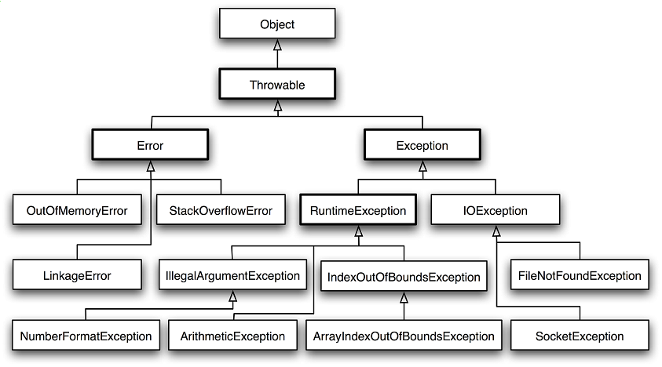
Exception Hierarchy in Java

Slide 11
The Flow of Exception Handling
When a “problem” occurs in a try block:
An exception is thrown
Program control immediately transfers to the first catch block matching the type of the thrown exception.
If we have a finally block it’s executed next
After the exception is handled, program control resumes after the last catch/finally block.

Slide 12
The Flow of Exception Handling
When a problem DOES NOT occur in a try block:
An exception is NOT thrown
The catch block(s) do NOT execute at all
Execution continues through the “try” block, then continues after the catch/finally block

Slide 13
Rules on the catch block
Must have one or more catches immediately after the try block
You can have more than one catch block
Only one catch block executes – the first matching one
The order matters:
There’s an Exception hierarchy
Child class must appear before parent classes
Why?
Usually have the generic Exception as the last class

Slide 14
catch Block
catch(IO.FileNotFoundException fnfe) { // handle file not found (using fnfe object) } catch(Exception e) { // handle other type of exception (using e object) }

Slide 15
finally Block
This is the “cleanup” block
Example: Operating systems typically prevent more than one program from manipulating a file.
Therefore, the program should close the file (i.e., release the resource) whether an exception was thrown or not
The finally block is guaranteed to execute regardless of whether an exception occurs.
Note: the finally block can’t see variables declared in the try or catch blocks

Slide 16
Full try/catch/finally Syntax
try {
// code that might generate an exception
}
catch( ChildExceptionClass e1 ) {
// code to handle an Exception1Class exception
} …
catch( ParentExceptionClass eN ) {
// code to handle an ExceptionNClass exception
}
catch ( Exception e ) {
// code to handle anything that made it
// through the first two catch blocks
}
finally
{
// code to execute whether or not an exception occurs
}

Slide 17
Best practice
Do not place try blocks around every statement that might throw an exception.
It’s better to place one try block around a significant portion of code and follow this try block with catch blocks that handle each possible exception.
Separate try blocks should be used when it is important to distinguish between multiple statements that can throw the same exception type.

Slide 18
Part 2: Throwing Exceptions
Inside a method, you can throw any kind of exception you want, at any time you want:
throw new Exception(); // OR
throw new FileIOException();

Slide 19
Throwing Exceptions in Java
In Java, must also use the throws keyword
Method states what kind of exception(s) it is throwing
Multiple exception types are separated by a comma
You must know the difference between the keywords throw and throws
Common interview question
Best shown through example

Slide 20
Example of Throw/Throws in Java
class Main {
public static void doStuff() throws Exception {
throw new Exception("CSE 1322");
}
public static void main(String[] args) {
try {
doStuff(); // This throws an exception
System.out.println("This line never prints");
}catch (Exception e) {
System.out.println("Exception thrown: "+e);
}
finally {
System.out.println("This prints no matter what");
}
}
}

Slide 21
Example in Java – Compile time error
class Main {
public static void doStuff() throws Exception {
throw new Exception("CSE 1322");
}
public static void main(String[] args) {
// The compiler knows this method throws
// an exception, so it forces you to use
// a try/catch
doStuff();
}
}

Slide 22
More Java Interview Advice
Interviewers also ask the difference between final, finally, and finalize
final – a keyword you can put in front of a method and attribute
finally – part of the exception handling flow of control
finalize( ) – a method that you inherit from the Object class, used for cleanup. Also be called a “destructor”, the opposite of a “constructor”

Slide 23
Part 3: Creating your own Exceptions
Why?
Example: building the software for a car
May want to create a CarNotStartedException
How: create a class that inherits from Exception
Include a default constructor
Include an overloaded constructor that takes in a string

Slide 24
Designing Your Own Exception Types
class InsufficientFundsException extends Exception
{
public InsufficientFundsException() {}
public InsufficientFundsException(String message)
{
super(message);
}
}

Slide 25
Checked and Unchecked Exceptions
Java distinguishes between two types of exceptions:
Unchecked exceptions
Inherit from of Error or RuntimeException
Not mandatory to use try and catch blocks to handle these exceptions.
Not checked by the compiler at Compile Time
Example: divide by zero
Checked exceptions
Inherit from Exception
Must be put inside a try block or the method must acknowledge that the exception may occur by using a throws clause in the method header.
Checked by the compiler at compile time

Slide 26
Checked vs Unchecked Exceptions

Slide 27
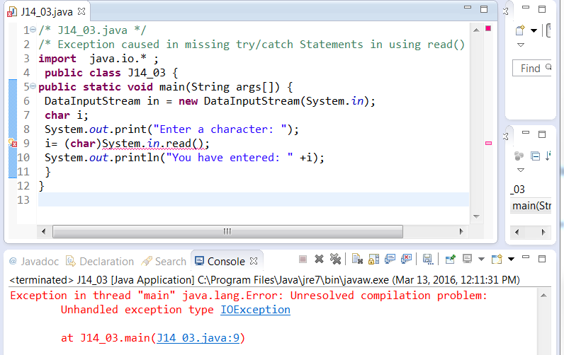
What kind of Exception?

Slide 28
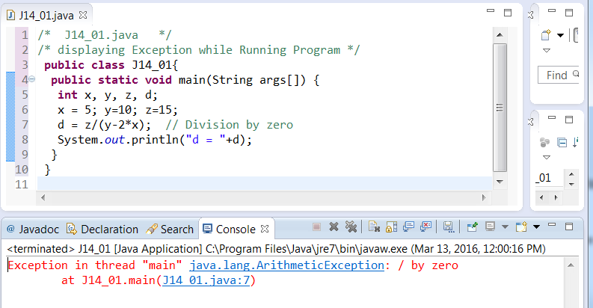
What kind of Exception?

Slide 29
Summary
Using exceptions helps with building robust, secure code
Uses keywords try, catch and finally
You can throw exceptions in methods
You can create your own exceptions by inheriting from an existing exception class

