Slide 1
Module 7 – Part 1
Basics, IO, and Types

Slide 2
Overview
Python and Java are both procedural and object-oriented languages
Procedural: you give the computer step-by-step instructions on how to complete a task
Object-Oriented: you may create classes which work as templates, from which objects can be created
Python is an interpreted language
Python reads your code line-by-line, translates it into machine code, and executes it
Java is a compiled language
Java reads all of your code, translates everything into machine code, and outputs bytecode (which is executed by the Java Virtual Machine)
Their syntax is similar overall, but different on the details

Slide 3
Interpreted vs Compiled
Interpreted languages
Code is sent to an interpreter, which converts it into machine code
Code must be interpreted every time it runs
Can be executed immediately
Can execute even if errors are present, but will crash once the error is reached
Harder to optimize, usually more resource-intensive
Usually friendlier
Compiled languages
Code is compiled by a compiler
Only needs to be re-compiled if changes are made
Cannot be executed until code is compiled
Will not execute unless there are no syntactic or semantic errors
Can be optimized, usually less resource-intensive
Usually less friendly

Slide 4
Skeleton - Java
All code must go inside of a class
The starting point of your code is always a method with the following header:
public static void main(String[] args){}
The class which contains the main method is usually called the “Driver”
The name of the class must match the name of the file

Slide 5
Comments and Commands
Python
A command usually ends once you hit enter
Comments must be prepended by #
Java
A command usually ends on a semi-colon
Comments must be prepended by //

Slide 6
Basic I/O – Python printing to screen
In Python, we use print()
If we want print() to not skip a line, we add a “end” parameter

Slide 7
Basic I/O – Java printing to screen
In Java, we use System.out.println().
If we don’t want to skip a line, we would instead use System.out.print() (notice the lack of ln)

Slide 8
Basic I/O – Python reading input
In Python, we have input(), which always returns a string.
input() may be given a string, which will be printed out

Slide 9
Basic I/O – Java reading input
In Java, we must first import the Scanner library
import java.util.Scanner;
You must then create a Scanner object (you only need to create one)
Scanner sc = new Scanner(System.in);
You can then use the Scanner object to read user input using nextLine()
Unlike Python, nextLine() does not take in any arguments.
If we want to give the user instructions on what they are supposed to input, we must print those instructions separately.

Slide 10
Basic I/O – Java reading input

Slide 11
Scope – Python
In Python, scope is determined by the amount of tabs present
Variables created in an inner scope don’t exist on an outer scope

Slide 12
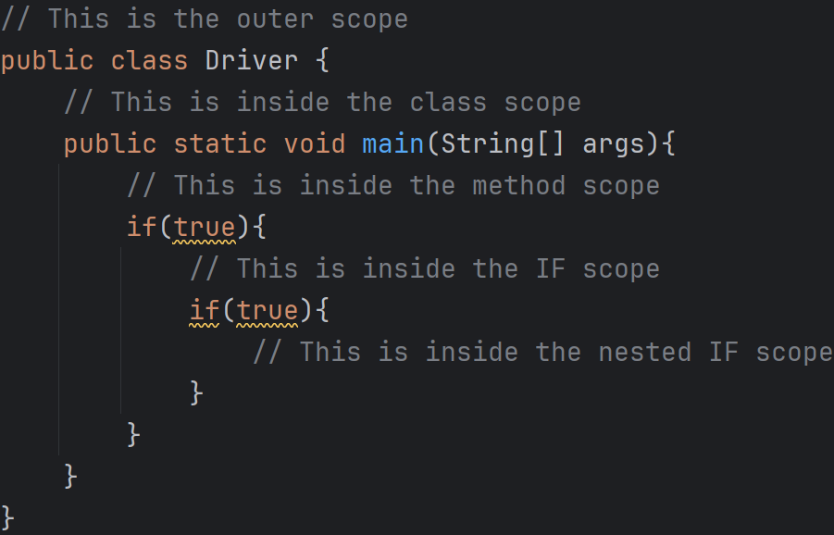
Scope – Java
In Java, scope is determined by the curly braces
Variables created in an inner scope don’t exist on an outer scope

Slide 13
Types
Python is dynamically typed
Python determines what the datatype of a variable is based on the value it receives
The variable’s type can change by doing a new assignment
name = value
Java is statically typed
You must specify the type of a variable when you declare it
The variable’s type cannot change inside that scope
type name = value;

Slide 14
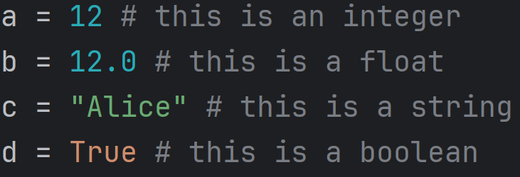
Types - Python
Integers: stores whole numbers of any size, positive or negative
Floating-point numbers: stores numbers with a decimal part
Strings: stores text
Boolean: Stores either True or False

Slide 15
Types – Java primitive types
byte: stores a whole number between -128 and 127
short: stores a whole number between -32,768 and 32,767
int: stores a whole number between -2,147,483,648 and 2,147,483,647
long: stores a whole number between -18,446,744,073,709,551,616 and 18,446,744,073,709,551,615
char: stores a single character, enclosed in single-quotes
boolean: stores true or false
float: stores a number with up to 7 digits after the decimal point
double: stores a number with up to 15 digits after the decimal point

Slide 16
Types - Java

Slide 17
Types - Java

Slide 18
Types – Java string
Strings are not considered primitive data types
We treat them as if they are, but the are actually objects
This means they have methods associated with them
Primitive types do not have methods associated with them

Slide 19
Types – (some) Java string methods
charAt(int): Returns the character at a particular position
contains(String): Returns true if the String in the parameters is contained in the String that called this method
equals(String): Compares if two Strings have exactly the same content
length(): Returns the length of the String
toLowerCase(): Returns this String in all lower-case letter
toUpperCase(): Returns this String in all upper-case letter

Slide 20
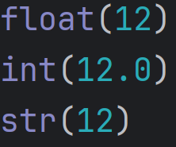
Casting - Python
In Python, we can cast (or convert) from one data type to another by using the appropriate method
float(): converts to a floating-point number
int(): coverts to an integer
str(): converts to a string

Slide 21
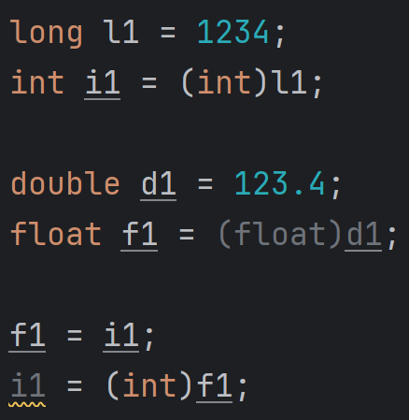
Casting – Java primitives
In Java, we can cast between primitives by writing the type we want to cast into inside parenthesis.
You only need to do this if information is being lost (i.e.: you are casting from a type that holds more information than another that holds less)

Slide 22
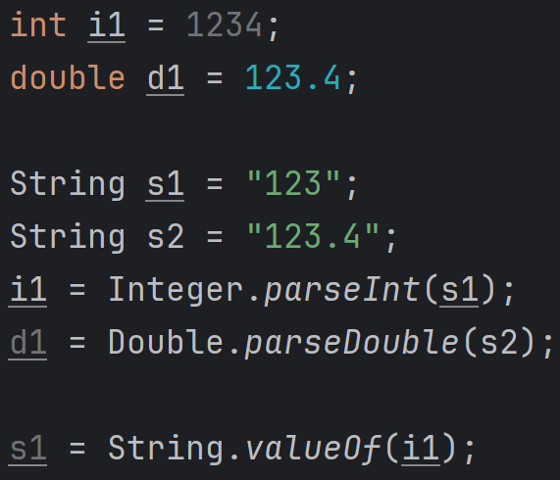
Casting – Java strings
Converting to and from Java String requires the use of special methods

Slide 23
Reading numbers from the user

