Slide 1
Module 4 – Part 1
Introduction to Pygame

Slide 2
What is Pygame
A group of Python modules for creating video games
Built on top of the SDL Library (Simple Direct Media), a development library for accessing audio, keyboard, mouse, and graphics hardware
Used a lot for video playback software and games
Downloaded millions of times
Supports dozens of platforms
Simple to use
https://www.pygame.org/

Slide 3
Installing Pygame (PyCharm)
Create a new project.
Click the “Terminal” button at the bottom left.
Type the following:
pip install pygame
Wait for it to finish installing
Create a new Python file
Type in “import pygame” and try to run it
If you get a message saying “No module named pygame”, your installation failed.
If your program runs without errors, your installation succeeded.
>_

Slide 4
Trying out Pygame
Pygame demonstrates its features through examples.
These can be found under pygame.examples.
You can check out the code for each example yourself (PyCharm):
Import the package in a Python file
Right-click the package name
Go To
Implementations
Some of them require extra files (such as music files) to work correctly.
We’ll go through some of them.

Slide 5
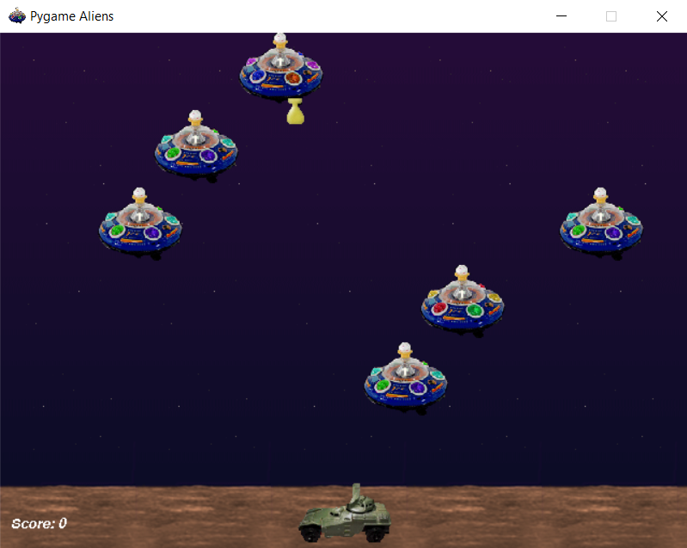
Trying out Pygame (Aliens)
A game where alien ships descend from the top of the screen.
They will shoot at the player.
If the ships or their shots collide with the player, it’s game over.
The player can move along the bottom and shoot back.
Try it

Slide 6
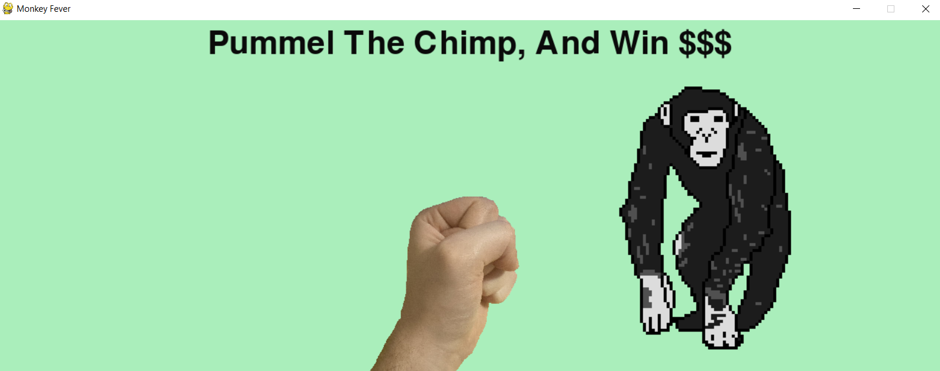
Trying out Pygame (Monkey Fever)
A game where a chimp slides across the screen
The player has a fist which they can move with the mouse.
Clicking the screen makes the fist punch forward.
If the chimp is punched, it spins in place, and a punching sound can be heard.
If the fist misses, a whiffing sound can be heard.
Try it

Slide 7
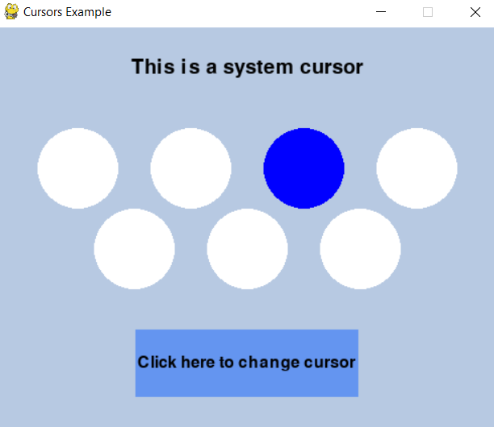
Trying out Pygame (Cursors)
More of a demo than an actual game
Demonstrates that Pygame can detect where the mouse is on screen.
The screen can react to the mouse’s presence
The button at the bottom changes how the mouse looks
Try it

Slide 8
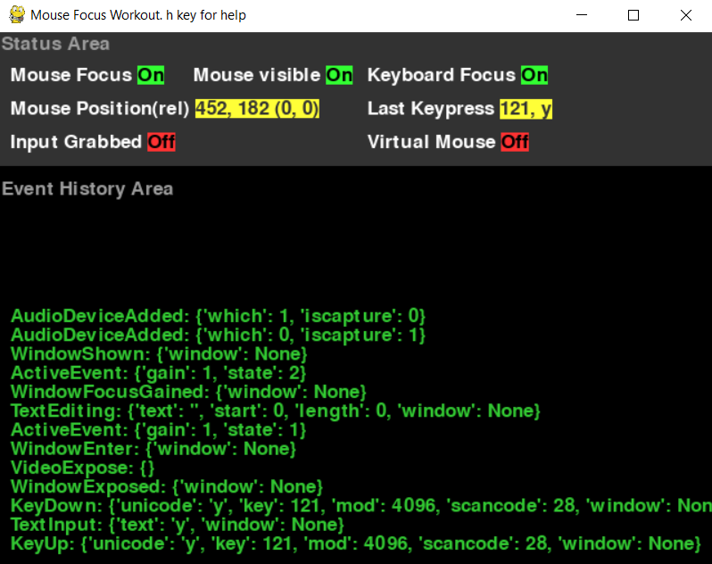
Trying out Pygame (Events)
Another demo
Demonstrates that Pygame can listen to events, such as mouse movements, clicks, button presses, etc.
Useful for understanding how Pygame handles events internally.
Try it

Slide 9
Trying out Pygame (Midi)
A simple piano
Keys can be clicked for sound.
Keyboard is also supported, using the second and third rows of keys
Try it

Slide 10
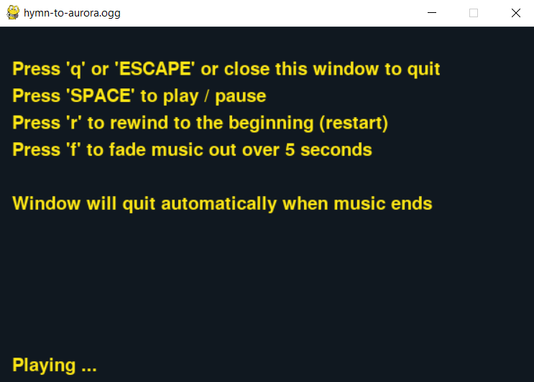
Trying out Pygame (Playmus)
Another demo
Shows that music can be played, as well as some of its controls.
You will need to place a music file in the same folder as your Python script for this to work
Make sure to pass the name of your music file to the playmus constructor
Try it

Slide 11
Structure of a Pygame application
While you can structure your game and code however you like, it’s best to start with a template (remember skeletons, from Module 1?). The template which we will be using is the one recommended by the Pygame documentation:
Load modules: Load any modules your game needs, including modules you’ve written yourself.
Manage external resources: Load any sounds, images your game needs. If your game is played over the network or if it supports saving and loading from the file, this is where you’d handle it.
Game classes and Functions: Any functions you need for your game to run.
Initializing the game: initialize Pygame, along with any of the resources above you need.
Start the main loop: This is where your program will spend most of its time. This loop will listen for events, and then handle them by updating the screen and the game objects as appropriate.

Slide 12
Pygame sample
# import modules
import sys, pygame
# manage external resources (currently empty)
# game classes and functions (currently empty)
# initialize the game
pygame.init()
size = width, height = 1024, 768
speed = [5, 5]
black = 0,0,0
screen = pygame.display.set_mode(size)
red_rect = pygame.Rect(0,0,50,50)
red_surf = pygame.Surface((red_rect.h, red_rect.w))
red_surf.fill(color=(255,0,0))
clock = pygame.time.Clock()

Slide 13
Pygame sample
# start the main loop
while True:
# listen for events
for event in pygame.event.get():
if event.type == pygame.QUIT: sys.exit()
# update the game objects as appropriate
red_rect = red_rect.move(speed)
if red_rect.left < 0 or red_rect.right > width:
speed[0] = -speed[0]
if red_rect.top < 0 or red_rect.bottom > height:
speed[1] = -speed[1]
# update the screen
screen.fill(black)
screen.blit(red_surf, red_rect)
pygame.display.flip()
clock.tick(60)

Slide 14
Pygame sample
You can paste the previous two slides in PyCharm (or whatever IDE you are using) and run it.
The example comes from here: https://www.pygame.org/docs/tut/PygameIntro.html
It’s simply a black screen, with a red square bouncing around.
Despite its simplicity, a lot of games can be made using that template.
We will be working off that template.
We’ll explain what the individual lines do in future slides.
For now, try to play around with the values in the method calls
See if you can figure out what changing a value does to the game
As our game grows, it will make more sense to move things around
Code inside our main loop might be moved to their own functions
Code that is logically connected might be moved to its own classes
Ideally, we want our final version to be readable
DON’T WORRY ABOUT ORGANIZING THINGS AS YOU CODE

