Slide 1
CSE 1321
Module 1 – Part 2
Data types, Expressions, Operators

Slide 2
Topics
Data Types
Python Data Types
Concatenation
Escape sequences
Converting between types
Comments
Expressions
Operators
Types of operators
Operator precedence

Slide 3
Data Types
Refers to the type of data a variable is storing
Knowing the data type lets us know what information a variable could be storing
It also lets us know the type of the result of an operation could be
In some programming languages, types also tell us how much space in memory is being used
Different programming languages may have different built-in types

Slide 4
Python Principal Built-in Types
Numerics: All numbers
Integers, floating-point numbers, complex numbers
Boolean value (technically numeric)
Sequences: ordered collections (more on this later)
Lists, tuples, ranges
Strings (technically sequences of characters)
Mappings: key/value collections (more on this later)
Dictionaries
Classes
Instances
Exceptions

Slide 5
Numeric types
Integers: whole numbers of any size
E.g.: 12
Floating-point numbers: decimal numbers
E.g.: 12.1
Have a precision of about 14 decimal places
Also include “nan” (not a number), “-inf” and “+inf”
Complex: Numbers with a real and an imaginary part
E.g.: 12+12j
Boolean: True or False
In Python, True and False must always have their first letter capitalized

Slide 6
Strings
A sequence of 0 or more characters
Enclosed by “double quotes” in other languages
Python accepts either ‘single’ or “double” quotes (cannot mix)
They are immutable, meaning they cannot change in memory
While it may seem that we are changing their contents when we assign it a new value, from the computer’s perspective, we are telling it to create a new string
Strings have things they can do (later):
len( ) – determines the number of characters
replace() – replaces part of the string with another string
lower() and upper() – changes the strings casing
isnumeric() – checks if the string is a number
split() – useful method for splitting a string

Slide 7
Printing & String Concatenation (the + operator)
String literals cannot span multiple lines (with some exceptions)
+ combines string literals with other data types for printing
Example:
print("Hello" + " " + "there");
Output: Hello there

Slide 8
Printing Escape Sequences
Printing an escape sequence prints a special character in an output string.
Common escape sequences:
\b is backspace. (e.g “B\bsecz\bret” prints what?)
\t is tab
\n newline
\r carriage return
\” double quote
\’ single quote
\\ backslash

Slide 9
Converting between types
To string: str()
Pretty much anything can be converted to a string
Be careful when converting anything else to a string!
To integer: int()
Floats will drop off the decimal part
Anything else will likely crash!
To floating-point: float()
Integers will now have a decimal part
Anything else will likely crash!
To complex: complex()

Slide 10
Comments
You can leave comments to yourself or to other developers
Comments are lines of code which are ignored by the computer
Useful for leaving notes explaining portions of code
Can be single line or multi-line
# this is a single line comment
‘‘‘this is a
multi
-line comment’’’

Slide 11
Expressions
An expression is a combination of one or more operators and operands
It has both a data type and a value that results from the expression evaluation
Operands may be:
literals (data written directly into the code)
constants (not present in Python)
variables
E.g.: variable3 = variable1 + variable2

Slide 12
Arithmetic Operators (Reminder)
Math operators
Addition (+)
Note the + sign can also be used for concatenation
Subtraction (-)
Multiplication (*)
Power (**)
Division (/)
Floor Division (//)
Modulus (%)

Slide 13
Division & Modulus
When dividing two values:
If using a single /, the result is a decimal number (even if the division has no remainder)
If using //, the result could be a decimal or whole number, rounded down to the nearest whole number
If one of the operands is a decimal number, the result is a decimal number
To get the remainder, use the modulus operator with the same operands
24 / 3 = 8.0
25 / 3 = 8.3
25 // 3 = 8
25.0 // 3 = 8.0
25 % 3 = 1
25.0 % 3 = 1.0

Slide 14
Be mindful about data types in expressions!
They determine what kind of operations you can do
input() will always produce a string
In other languages, adding a string to a number is always a concatenation
In Python, strings can only be concatenated (+) with other strings, but not with numbers
Strings can be multiplied by an integer (what does this do?)
Any arithmetical operation between two integers will produce an integer (except division)
Any arithmetical operation between an integer and a float will produce a float

Slide 15
Comparison Operators
Equality (==)
NOT =, single = means ASSIGNMENT
Inequality (!=)
Greater than (>)
Less than (<)
Greater than or Equal (>=)
Less than or Equal (<=)
in, not in, is, is not (we’ll see these later)

Slide 16
Logical Operators
not, and, or
These operators work with Boolean Logic
A | B | A or B
TRUE | TRUE | TRUE
TRUE | FALSE | TRUE
FALSE | TRUE | TRUE
FALSE | FALSE | FALSE
A | B | A and B
TRUE | TRUE | TRUE
TRUE | FALSE | FALSE
FALSE | TRUE | FALSE
FALSE | FALSE | FALSE
A | not A
TRUE | FALSE
FALSE | TRUE

Slide 17
Operator Precedence
Operator | Description
(expressions...), | Binding or parenthesized expression, list display, dictionary display, set display
[expressions...], {key: value...}, {expressions...}
x[index], x[index:index], x(arguments...), x.attribute | Subscription, slicing, call, attribute reference
** | Exponentiation
*, /, //, % | Multiplication, division, floor division, remainder
+, - | Addition and subtraction
in, not in, is, is not, <, <=, >, >=, !=, == | Comparisons, including membership tests and identity tests
not x | Boolean NOT
and | Boolean AND
or | Boolean OR

Slide 18
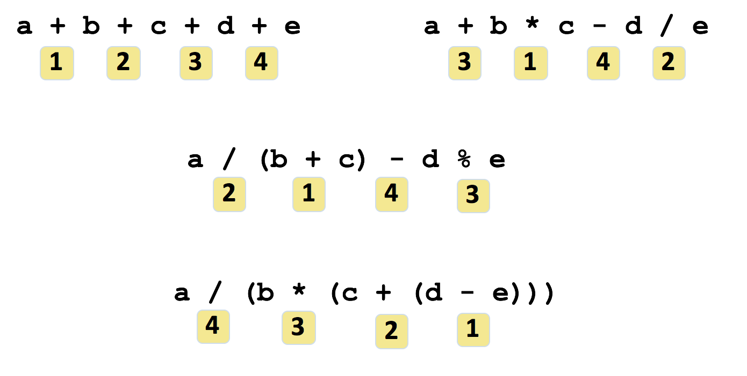
Operator Precedence (Example)

Slide 19
Shortcut Operators
Operator | Example | Equivalent
+= | a += 3; | a = a + 3;
-= | a -= 10; | a = a - 10;
*= | a *= 4; | a = a * 4;
/= | a /= 7; | a = a / 7;
%= | a %= 10; | a = a % 10;

Slide 20
Summary
Data type tells how much memory to allocate, the format in which to store data, and the types of operations you will perform on data.
Conversion can be made between data types, with some limitations
There are arithmetical, comparison, and logical operators
Operators have different orders of precedence

